Slide 1
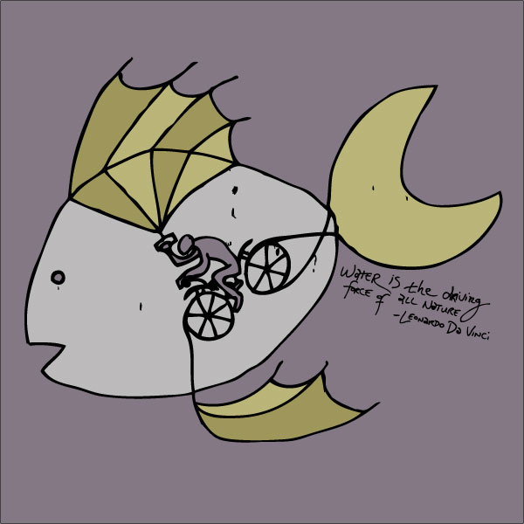
Toward Human-Interaction with Bio-Inspired Robot Teams
HuBIRT
Michael A. Goodrich
Brigham Young University
P.B. Sujit
University of Porto
ONR via CMU
RCTA via USF

Slide 2
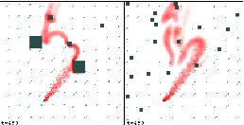
What types of problems
Barnes & Fields:
Convoy protection
Spears
Plume tracking
Abstraction: Information Foraging
Resource depletion rate
N=5

Slide 3
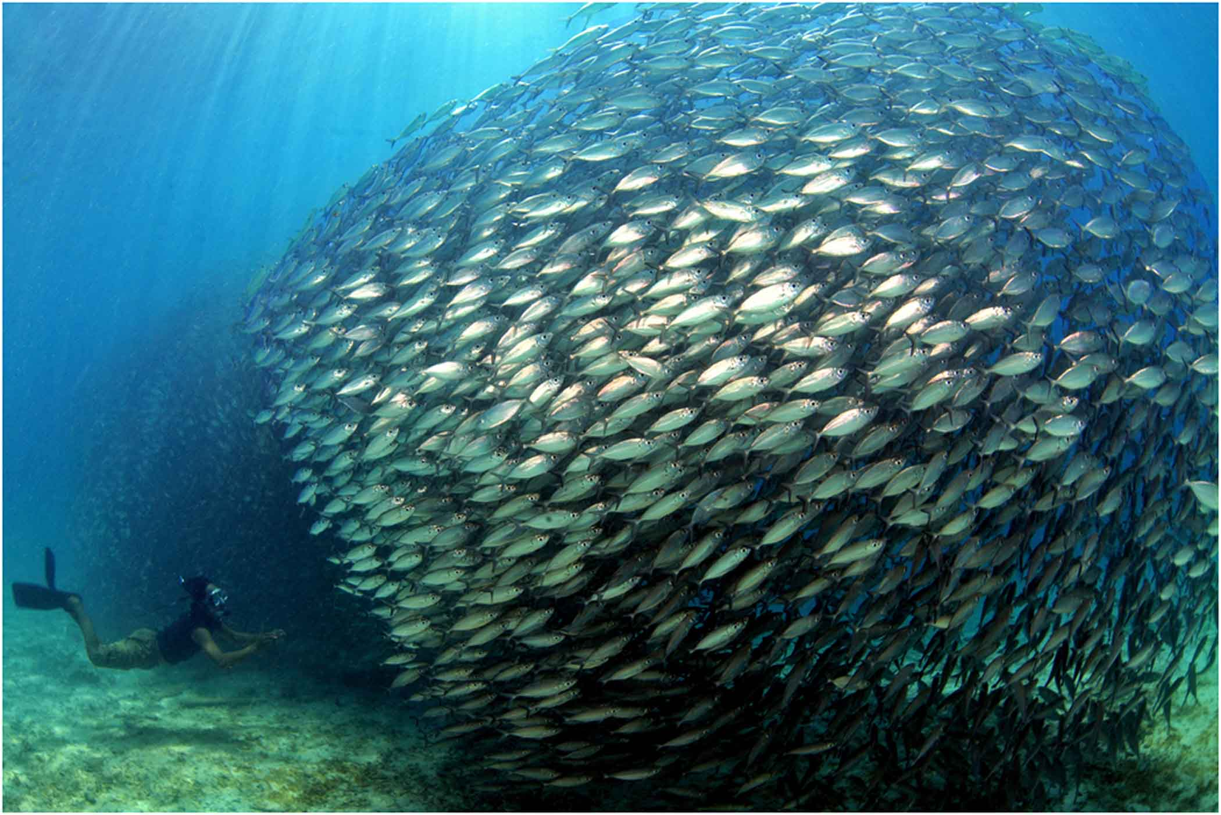
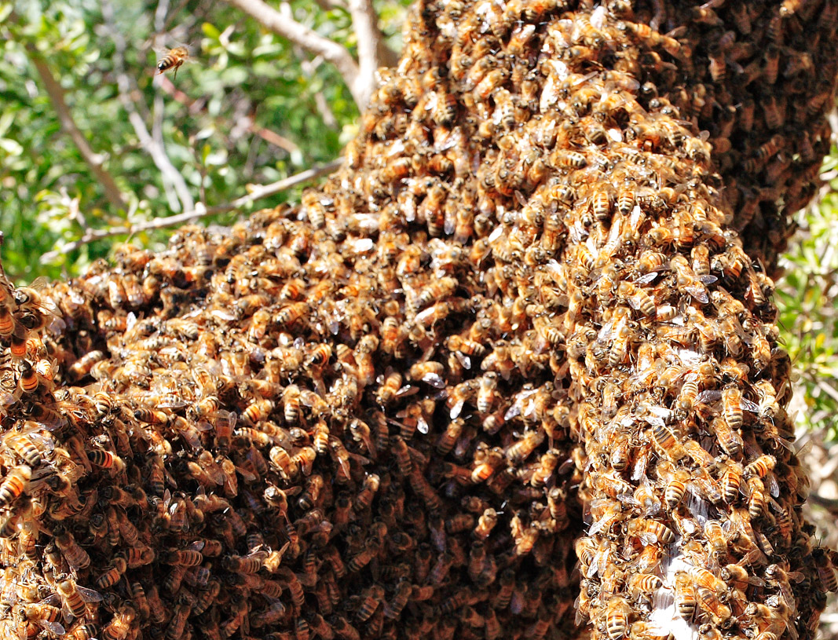
Which Types of Bio-Inspired Teams?
Simple agent behaviors
Collective group intelligence
Goal-driven group behavior

Slide 4
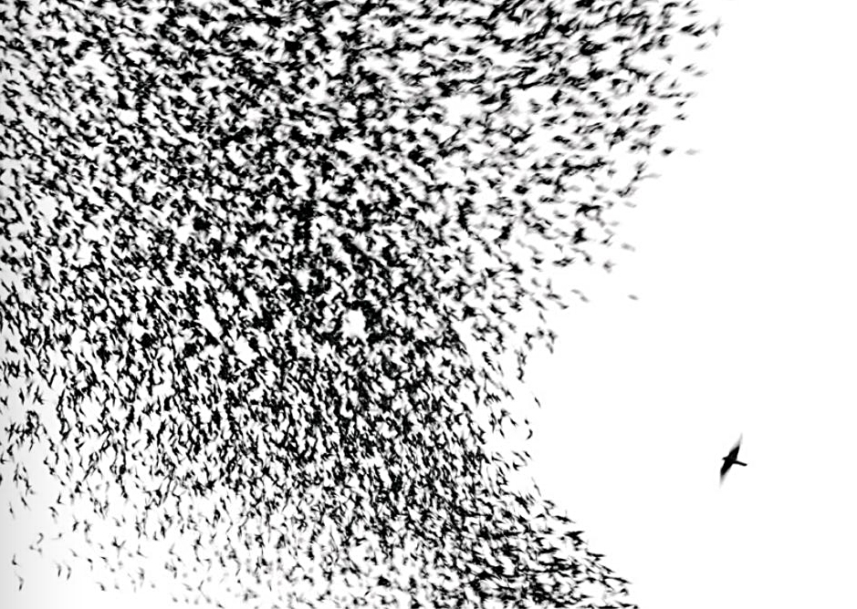
Model Class: Inter-Agent Influence + External Influence
Sumpter
Positive feedback: “imitation or recruitment behaviour [yielding] collective patterns.”
Negative feedback: inhibition that yields stable collective behavior
Individual: each agent has its own state
Reynolds
Mutual attraction
Mutual repulsion
Mutual alignment
Restrict to additive model (for now)

Slide 5
HuBIRT Model: Connectivity and Sparseness
Egerstedt:
Stable decentralized control relies on connectedness
Ballerini:
Natural models use structured sparseness
Autonomy
Assumption:
what else
influences me?
Cohesiveness
Adjacency Matrix:
who influences me?
Notes:
A_t = \left[ \begin{array}{ccccc} 0 & 1 & 0 & 0 & 1 \\ 1 & 0 & 1 & 0 & 1 \\ 0 & 1 & 0 & 1 & 0 \\ 0 & 0 & 1 & 0 & 1 \\ 1 & 1 & 0 & 1 & 0 \end{array} \right]

Slide 6
Inter-agent Connectivity: Structured Topologies
Power-limited Comms
Metric-based topologies
Bandwidth-limited Comms
Nearest-neighbor topologies
N = 5
N = 5

Slide 7
Model: Human Influence
Autonomy: an agent’s response to an external signal
Depends only on the signal
And the agent’s own state
Two external influences
Operator input
Environment signals
Notional
Management
Adjacency Matrix:
Which agents are affected by human?

Slide 8
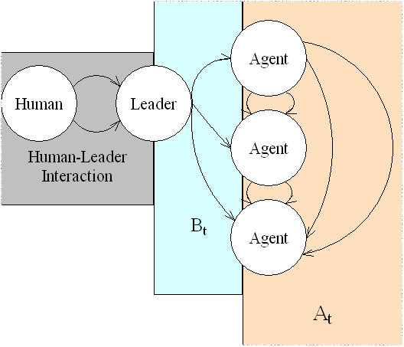
Experiment Design: Human Influence
State-of-the-Art
Centralized leader with decentralized formation
Centralized selection of model parameters
Decentralized w/o human
Ad hoc
Leaders and Predators
Sumpter: what is a leader?
Decentralized leader influence

Slide 9
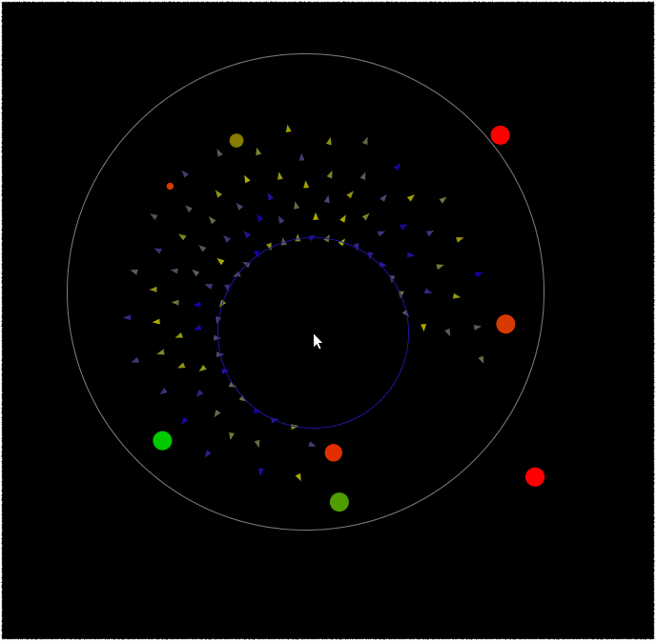
Experiment Design: One natural & one artificial structure
Bio-mimetic
Imitate a biological system
Zoomorphic agents
Couzin et al., 2002
Physico-mimetic
Imitate an artificial system
Point-mass agents
Spears et al., 2005

Slide 10
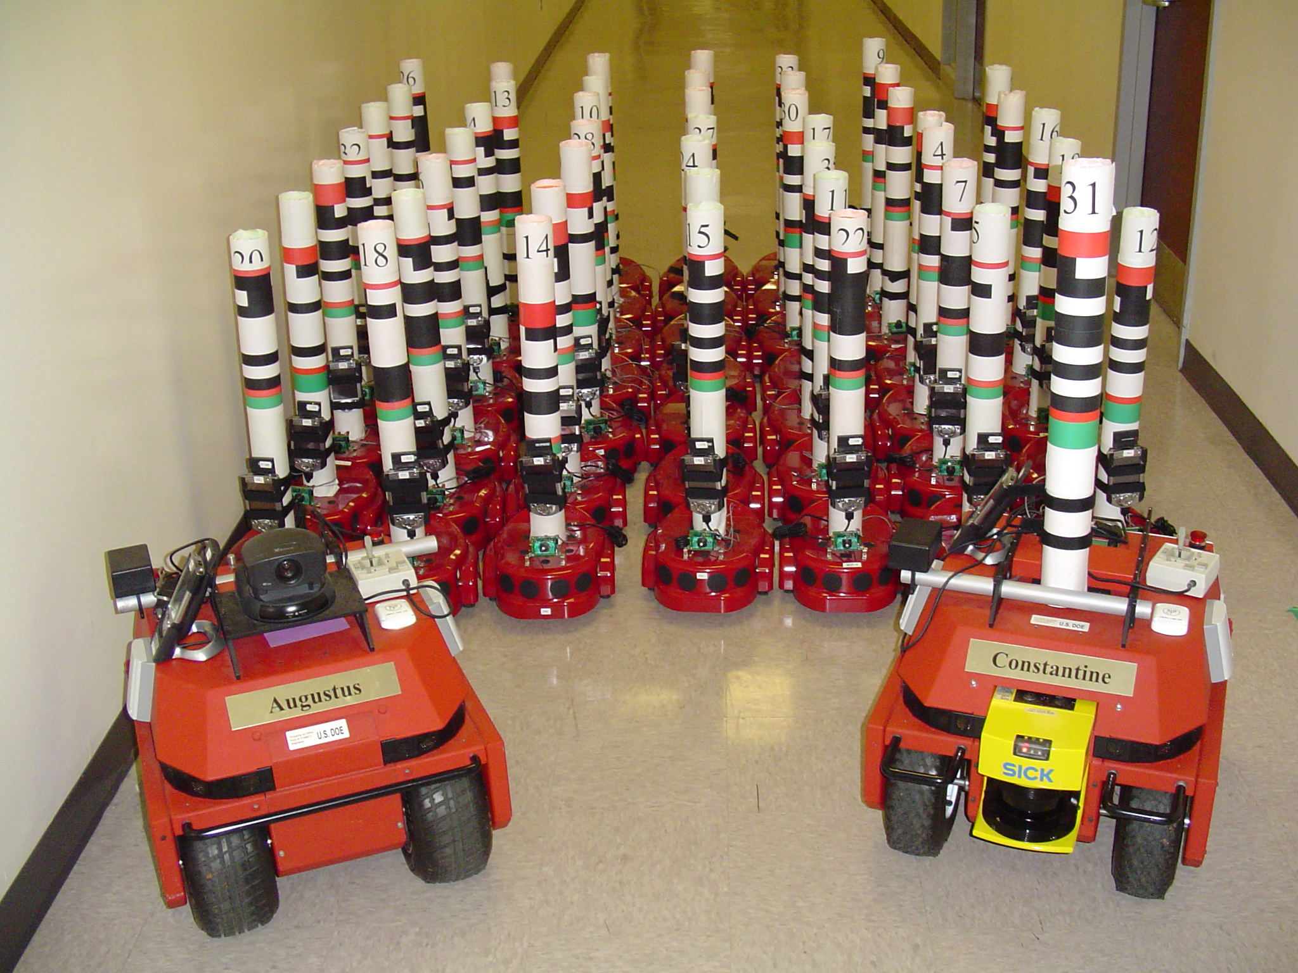
Building Intuition w/ Experiments: How relevant to real robots?
Ecologically Valid
Topological connectivity
Limited inter-agent communication
Human influence over a small subset of agents
Additive inter-agent influence
Human operators
Not Valid
Human can observe state of all agents
Holonomic, noise-free dynamics
Noise-free communication
Few operators
L. Parker

Slide 11
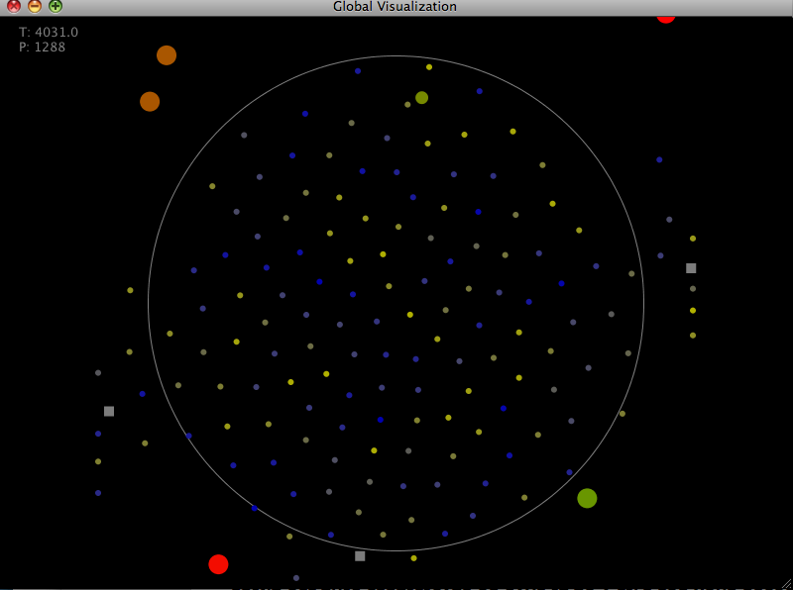
Sample Models: Physico-mimetic
Physico-mimetic
Agents as point masses
Attract and repel

Slide 12
Sample Models: Bio-mimetic
Bio-mimetic
Couzin’s instantiation of
Reynold’s “Boids” model
Conradt:
Split and Steer
Split and Steer
Repulsion
Alignment
Attraction

Slide 13
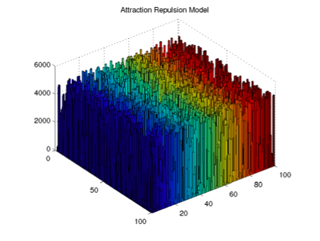
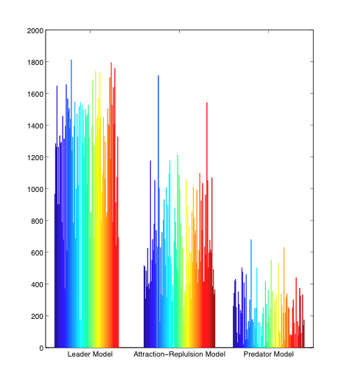
Metrics: time histories
Adjacency matrix time-histories =
evolution of collective structure
under human influence

Slide 14
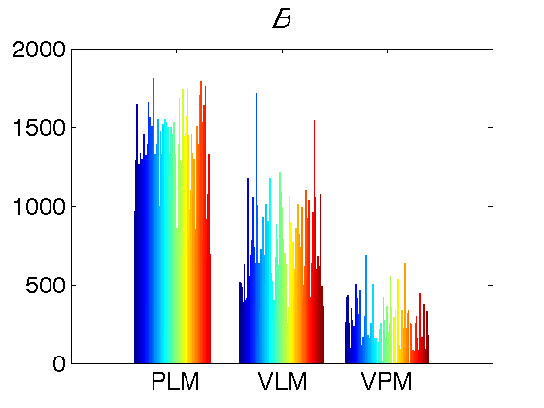
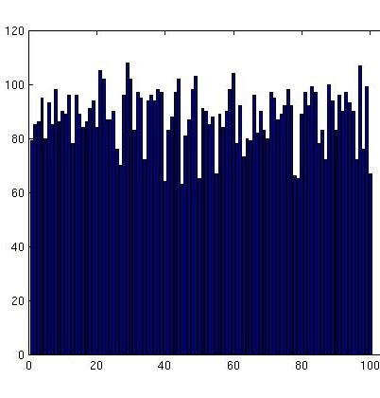
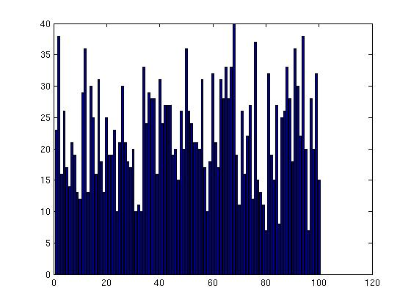
What Types of Human Influence? Empirical Correlates w/ Performance
Experiments
Leaders
Sustainable human influence
Predators
Unsustainable human influence
Need team of predators
Leader
Physico-
mimetic
Predator
Leader-1
Leader-2
Predator
Biomimetic
Notes:
Results shown for Metrics

Slide 15
What Types of Human Influence? Empirical Correlates?
Experiments
Leaders
Coherent?
Predators
Coherent?
Physicomimetic
Notes:
Metric topology, biomimetic is very similar

Slide 16
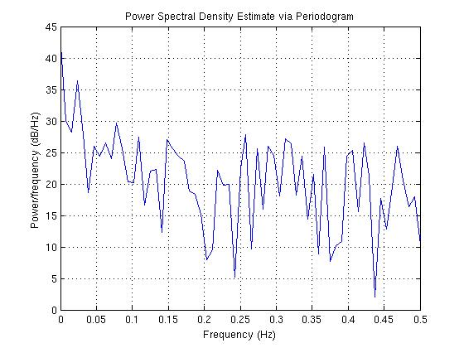
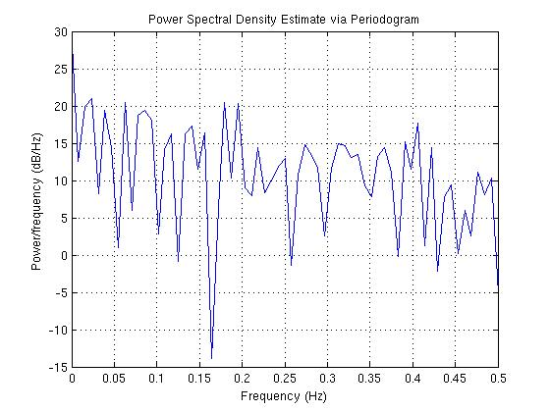
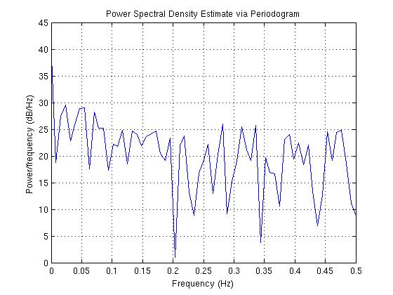
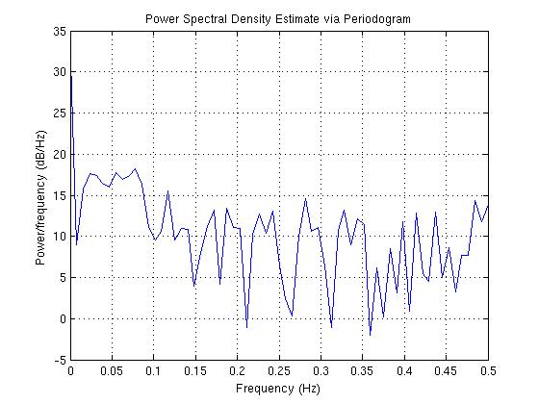
What Types of Topologies? Empirical Correlates w/ Performance
PSD of
Metric
Less coherent
Nearest Neighbor
Coherent
Leader
Ballerini’s
observation
Predator

Slide 17
Communication Requirements Empirical Results
Robust to communication drop-outs
Two Leader models
Virtual requires sustained remote communication
Physical requires intermittent remote and sustained local communication

Slide 18
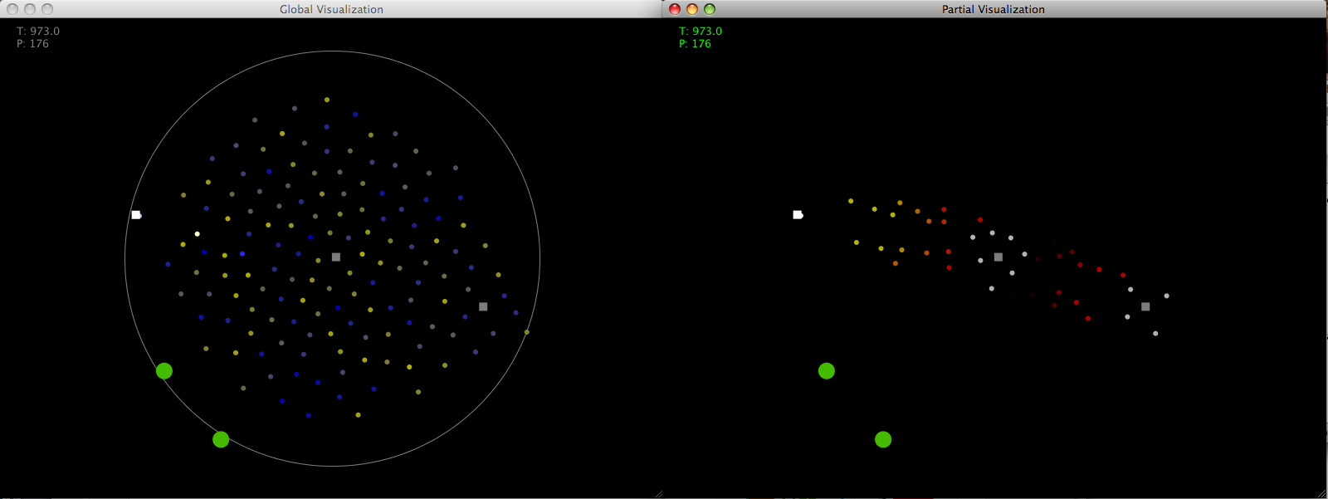
Phase I: Partially Observable Collectives
A common unrealistic centralization assumption
Partially observable with time delays
Active Sensing
Leaders = Observers
Centroid and fringe agents
Zig-zag agents
Consensus
Leaders/
Observers
Observed
Agents
Ground Truth
Observable States

Slide 19
Phase II: Multi-operator Management
Conradt et al. 2009
Operator 1 Leads
Operator 2 Leads
Task Assignment

Slide 20
Phase III: Include Autonomy
Autonomy and Heterogeneity

Slide 21
Information and HuBIRT: Phase III continued …
Semi-random processes
Low
High

Slide 22
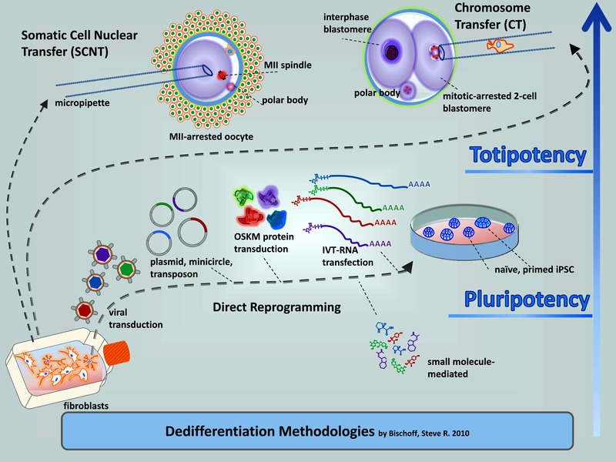
Filling out the Spectrum: Phase III continued …
Complexity of Required Collective Behavior
Low
High

Slide 23
Team Capacity: Phase III continued …
Hypothesis: BIRT structures have invariant information-processing capacities
Team 1
Capacity
Team 2
Capacity
Low
High

Slide 24
Operator Modulation: Phase III continued …
Hypothesis: HuBIRT structures have invariant operator response curves
Responsiveness = amount of entropy removed by human
Team 2 Operator
Response Curve
Team 1 Operator
Response Curve
Low
High
Notes:
Human Input:
If bits, then probably doesn’t go back up
If bits per second, then probably does go back up because info input outstrips rate of completion (thrashing)

Slide 25
HuBIRT Organizational Tolerance: Phase III continued …
Match BIRT structure to environment
Match HuBIRT structure to human factors constraints
L
H
L
H
Organizational tolerance is worst case task rate
Design to match organizational and task tolerances

Slide 26
Insights
It’s easier for a human to manage neighborhood-based teams
Predator-based and Leader-based human interactions offer different advantages
Leader-based models guide a coherent team
Predator-based models decohere a team to allow multi-tasking
Graph theory formulation and metrics offer design vocabulary for HuBIRT organizations

Slide 27
Phase IV: Necessity & Sufficiency
Sufficiency
Observability Matrix
Controllability Matrix
Characteristic Polynomial and Graph Valence
Correlates w/ necessity
Signal propagation time
Probability of decoherence
Coherence strength
Robustness
Mutual Information

Slide 28
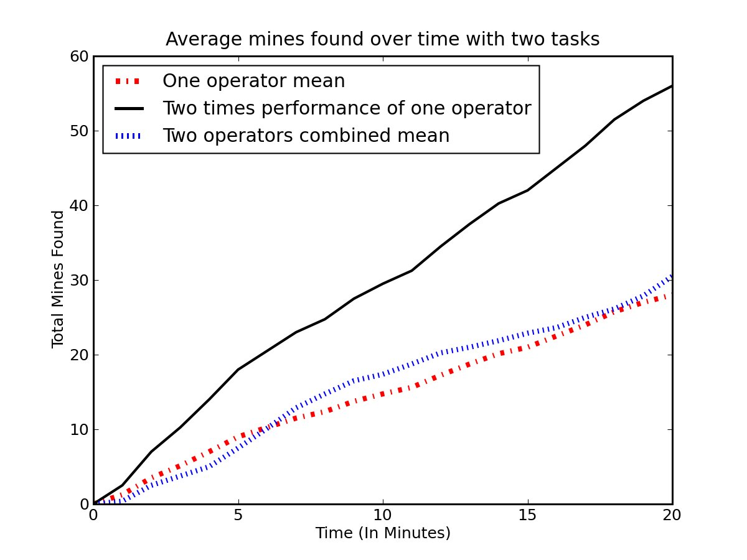
Sometimes 2<2x1: Environment Constraints
Task Saturation
Adding more robots won’t improve performance
Example: 4 small boxes carried by 4 robots versus 4 small boxes carried by 5 robots
Task Diffusion
Task gets harder as sub-tasks are accomplished
Example: Mine-sweeping
2<2x1

