Slide 1
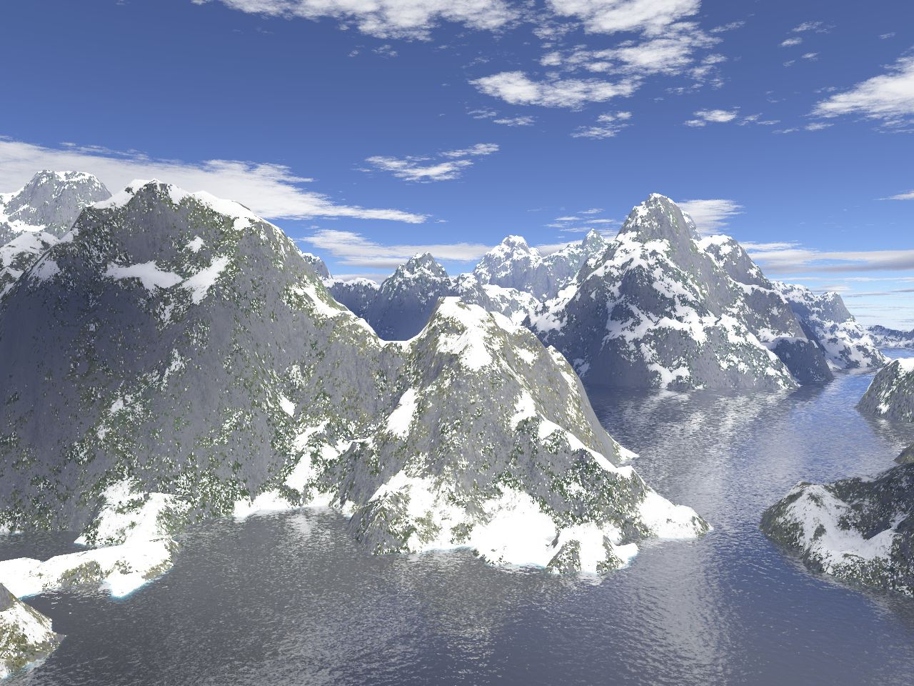
Midpoint Displacement for Terrain
CS 658

Slide 2
What problem are we solving?
For me, it’s making terrain sets for games or movies.
For the field in general, it’s a bit broader.
Art.
The connection between fractal geometry and landforms.

Slide 3
What have others done?
Fractional Brownian Motion
A true fractal.
Various approaches to generating fBm.
Why not do that?
Midpoint displacement is more efficient.
It’s an approximation to fBm which looks good enough.

Slide 4
What are they going to do?
Midpoint displacement.

Slide 5
Midpoint Displacement in 1D

Slide 6
Midpoint Displacement in 1D

Slide 7
Midpoint Displacement in 1D

Slide 8
Midpoint Displacement in 1D

Slide 9
Midpoint Displacement in 1D
For each line segment:
Find the midpoint
Randomly displace the midpoint a distance which is proportional to the length of the line segment
Draw two lines between the new midpoints.

Slide 10
Midpoint Displacement in 2D
Initially, the elevation is constant and known.
Take the average of those 4 elevations, displace the average and assign that to the displacement of the midpoint of the square formed by those 4 corners.
The amount of displacement is a fucntion of the distance between the points and the “roughness” of the terrain.
This forms diamonds (hard to see in the first step).

Slide 11
Midpoint Displacement in 2D
Initially, the elevation is constant and known.
Take the average of those 4 elevations, displace the average and assign that to the displacement of the midpoint of the square formed by those 4 corners.
The amount of displacement is a fucntion of the distance between the points and the “roughness” of the terrain.
This forms diamonds (hard to see in the first step).

Slide 12
Midpoint Displacement in 2D
Step 2: For each diamond,
Find the midpoint.
Find the average elevation of the corners of the diamond.
Displace the midpoint.
Assign that value to the midpoint.
(Shown here for just the blue diamond)
Thought question: what do you do about the corner which lies off the grid?

Slide 13
Midpoint Displacement in 2D
Step 2: For each diamond,
Find the midpoint.
Find the average elevation of the corners of the diamond.
Displace the midpoint.
Assign that value to the midpoint.
Points with known elevations are shown in red.
Now we have boxes again.
Repeat step 1 with smaller boxes.

Slide 14
Midpoint Displacement in 2D
Step 1 (second time through)
For each box,
Find the average elevation of the corners.
Displace that and assign it to the midpoint.
Shown for each box using a different color for the points used for each box.
Some points are used more than once.
Now we have diamonds again. Repeat step 2.

Slide 15
Midpoint Displacement in 2D
Step 1 (second time through)
For each box,
Find the average elevation of the corners.
Displace that and assign it to the midpoint.
Shown for each box using a different color for the points used for each box.
Some points are used more than once.
Now we have diamonds again. Repeat step 2.

Slide 16
Midpoint Displacement in 2D
Points with known elevation in red
Step 2 (second time)
For each diamond,
Find the average elevation of the corners
Displace it.
Assign that elevation to the center.
Again, what to do with corners that lie off the grid?
Left with boxes.

Slide 17
Midpoint Displacement in 2D
Points with known elevation in red
Step 2 (second time)
For each diamond,
Find the average elevation of the corners
Displace it.
Assign that elevation to the center.
Again, what to do with corners that lie off the grid?
Left with boxes.

Slide 18
Midpoint Displacement in 2D
Step 1 (third time)
For each box,
Find the average elevation of the corners
Displace it.
Assign that elevation to the center.
Now we have diamonds.

Slide 19
Midpoint Displacement in 2D
Step 1 (third time)
For each box,
Find the average elevation of the corners
Displace it.
Assign that elevation to the center.
Now we have diamonds.

Slide 20
Midpoint Displacement in 2D
Step 1 (third time)
For each box,
Find the average elevation of the corners
Displace it.
Assign that elevation to the center.
Now we have diamonds.
Repeat step 2 again.

